Slide 1
Diagnostics Communication Manager (DCM)

Slide 2
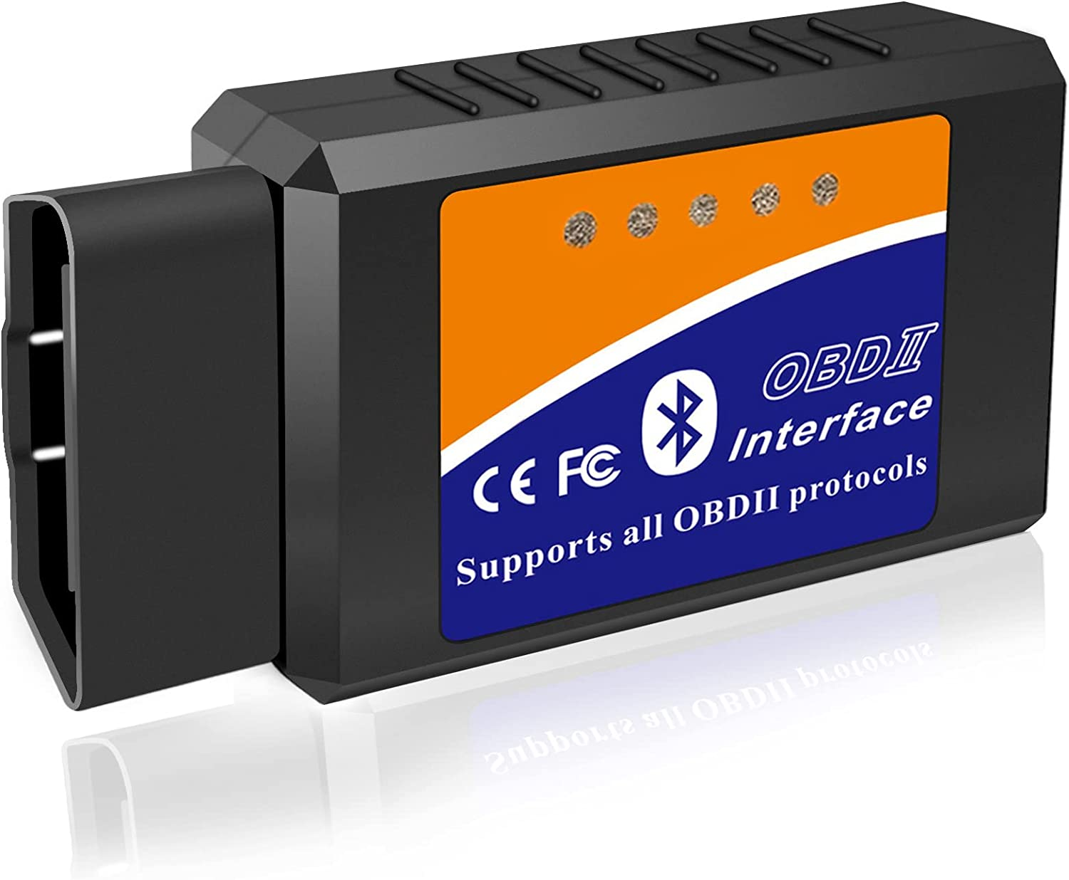
Vehicle Diagnostics
Vehicle Diagnostics helps to analyze the health of a vehicle, by checking the parameter (based on sensors) data and fault related data.
They are classified as On Board Diagnostics (OBD) and off board diagnostics (UDS – Unified Diagnostics Services)
OBD is the vehicle’s built in diagnostics setup, earlier which used to use MIL (Malfunction Indicator Light) and these days provide communication interface through which real time data and fault related data (Diagnostic Trouble Codes – DTCs) can be queried.

Slide 3
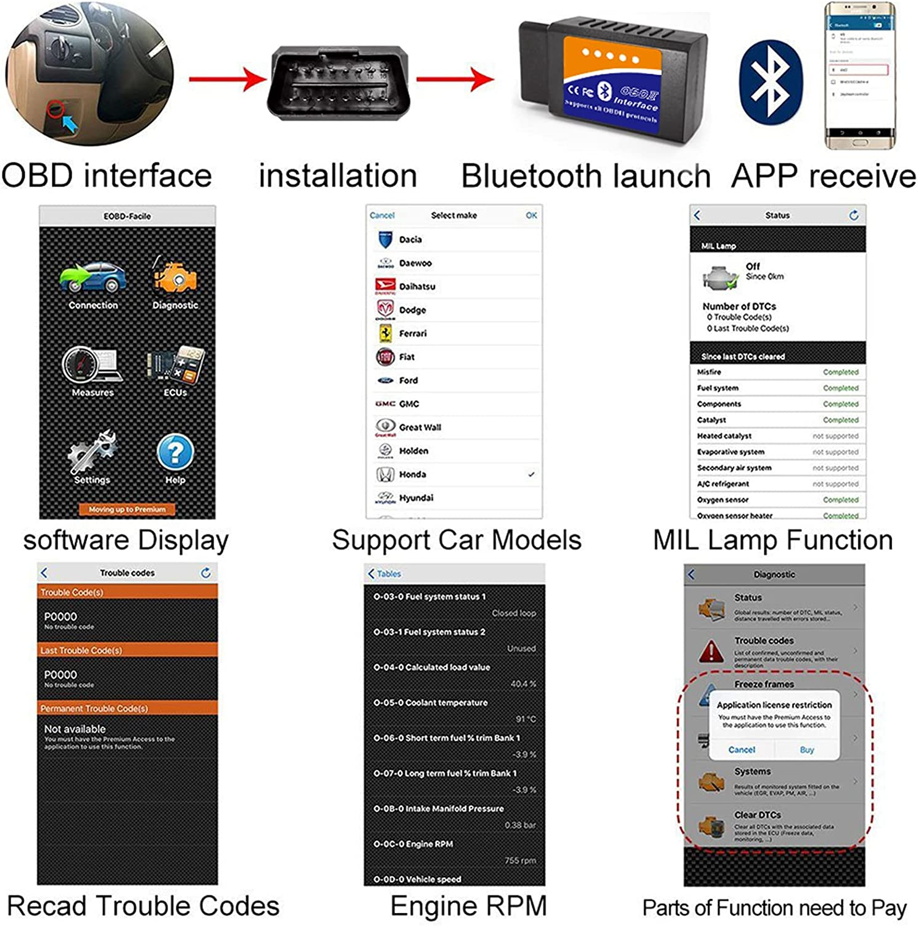
OBD Diagnostics

Slide 4
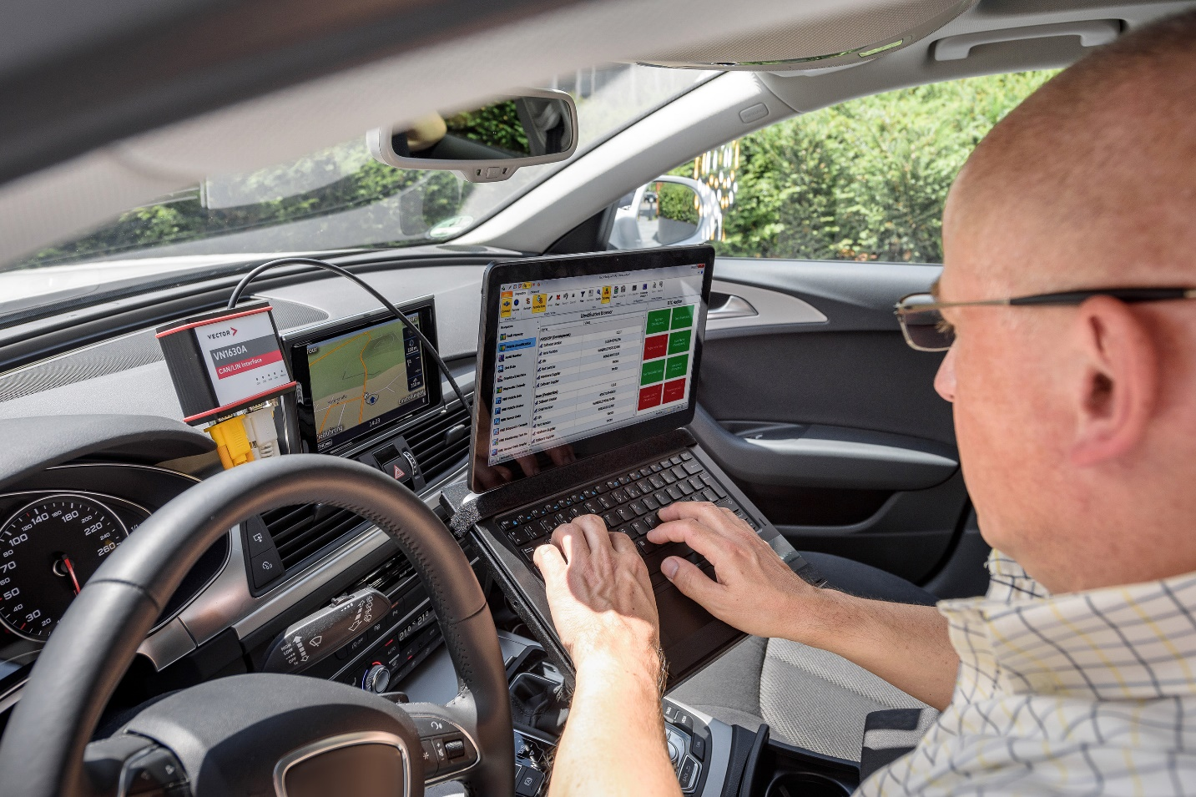
Off-Board Diagnostics:UDS Services
Off-board Diagnostics uses the UDS (Unified Diagnostics Services) Protocol ISO 14229-1, which needs a separate tester setup, like a laptop with Client Tester software installed.
This is to be connected to the vehicle’s off-board diagnostic interface.
Now UDS service requests can be sent to the controller, which must respond either with a positive or negative response

Slide 5
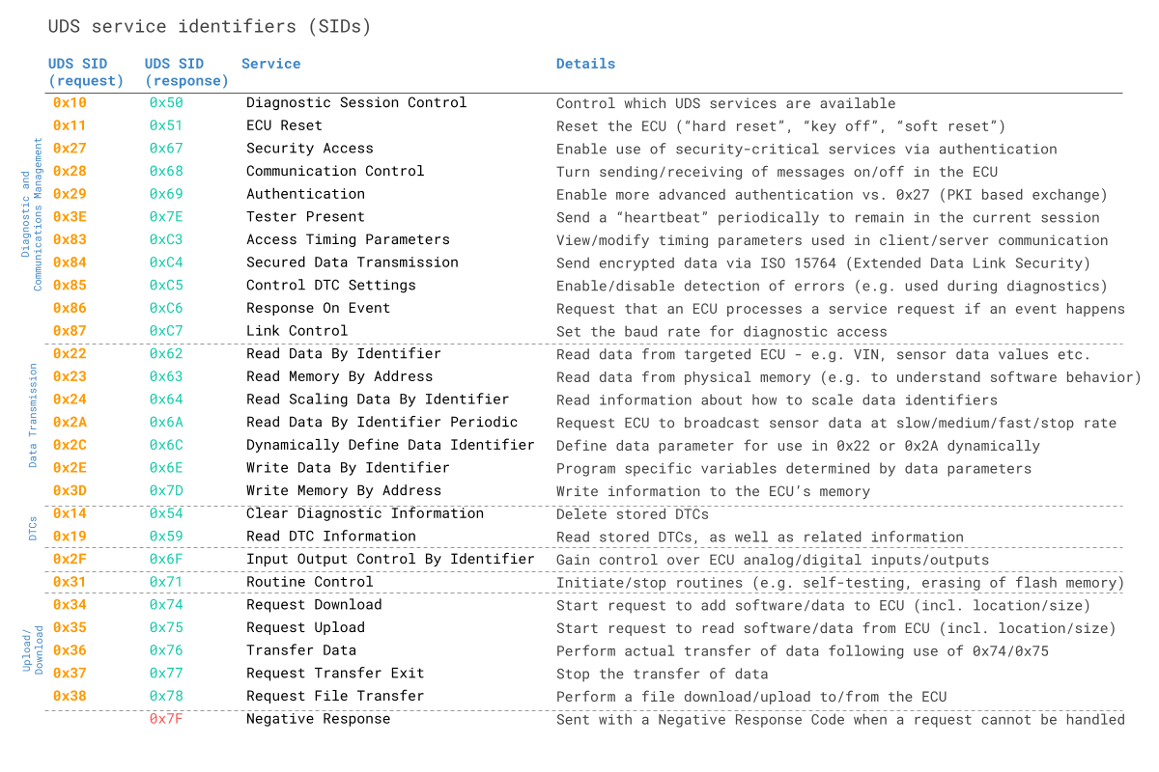
UDS Services

Slide 6
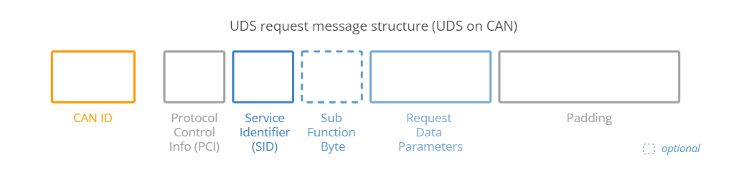
UDS Services: Request Message Structure
PCI (Protocol Control Information): Contains information related to CAN-TP, which deals with transmission of messages which cannot be fit into a single CAN Frame. It can be 1-3 bytes long.
Service Identifier (SID): ID of the UDS service to be used. (1 Byte)

Slide 7
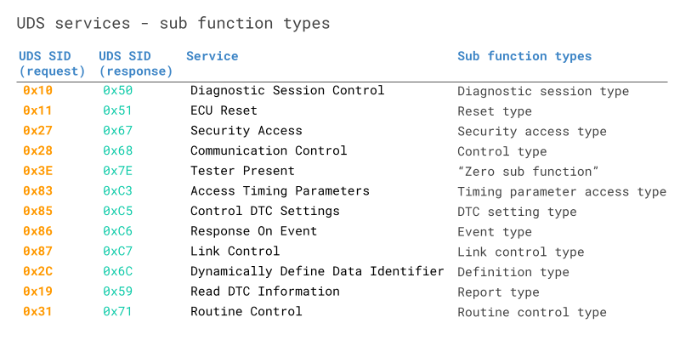
UDS Services : Request Message Structure
Sub-function Byte: Some services requires additional data (similar to arguments in a function call). Is 1 byte long and can have up to 128 sub function values using 7 bits (1st bit is used for positive response enable/disable). This is optional.

Slide 8
UDS Services : Request Message Structure
Request Data Parameters: Used to give further configuration of a request beyond the Sub Function Bye. For example when using 0x22 “Read Data by Identifier” Service, this field can used to provide the DID (Data Identifier).
Padding: To keep the total size of the CAN data frame fixed as 8 bytes.

Slide 9
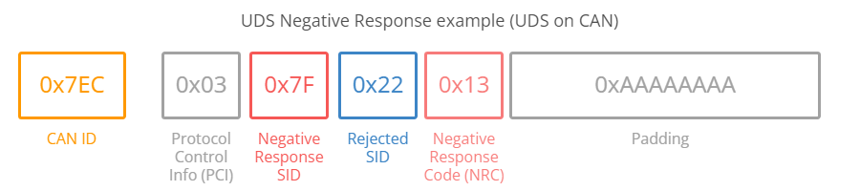
UDS: Positive & Negative Response
The ECU can respond positively or negatively to a UDS request.
The Positive response follows a similar structure as the request and will contain the requested data if applicable. The response SID is the request SID+0x40. For example if the request SID is 0x22, then the response SID will be 0x62.
The ECU will give a negative responses in some cases, which is structured in the following CAN frame format:

Slide 10
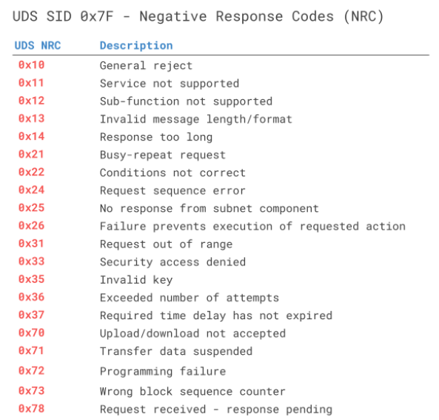
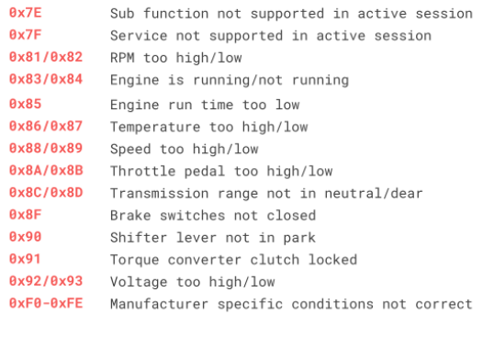
UDS: Negative Response

Slide 11
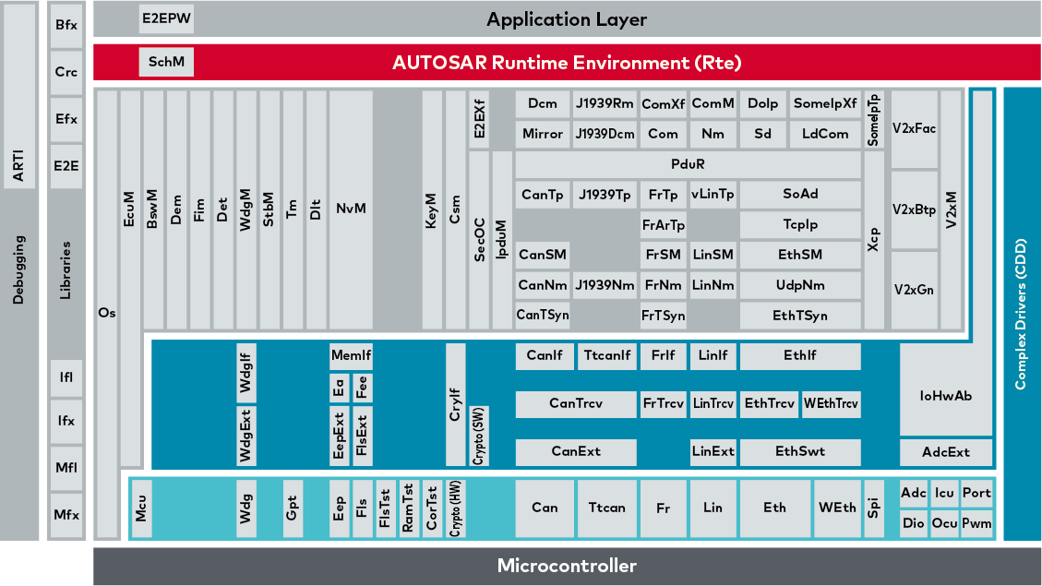
Diagnostics: AUTOSAR Software Stack

Slide 12
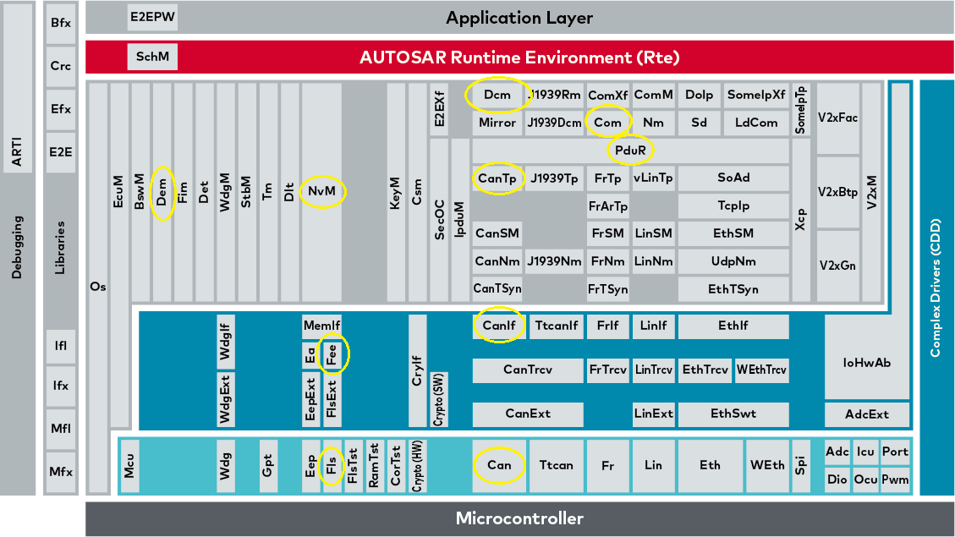
Diagnostics: AUTOSAR Software Stack

Slide 13
Diagnostics: AUTOSAR BSW Software Stack
DCM (Diagnostics Communication Manager): Responsible for handling the diagnostics related communication, ie the diagnostic services. It receives the service request, validates it, takes proper action and send the response back.
DEM (Diagnostic Event Manager): Responsible for processing diagnostic events, storing the related data (DTCs) to the NvM (Non Volatile Memory) and also providing the same to the DCM.
CAN: CAN driver stack in the MCAL layer which manages the CAN transceiver.
CANIF (CAN Interface): Present in the ECU Abstraction layer. Provides interface for the upper layer to manage the CAN Driver.

Slide 14
Diagnostics: AUTOSAR BSW Software Stack
CANTP (CAN Transport Protocol): Responsible for segmentation, transmission and reception of CAN frames having payload higher than 8 bytes. Follows the ISO 15765 CAN TP standard.
PDUr (PDU Router): PDUr routes the PDU to the respective Bus specific interface modules. (PDU: Protocol Data Unit – can be roughly considered as a package of signals. Signals are smallest amount of information in a CAN message, ranging from 1 to 64 bits). The PDU is also responsible for routing the CAN frame to CAN-TP if the payload is greater than 8 bytes.
COM (Communication Stack): Responsible for packing and unpacking of PDUs into signals and vice-versa. It provides signal oriented interface to the application layer (independent of protocol) and PDU oriented access to the lower layers.

Slide 15

Diagnostics: AUTOSAR Software Stack

Slide 16
Diagnostics: AUTOSAR BSW Software Stack
NVM (Non Volatile Memory Stack): Responsible for the read and write functions to the non volatile memory. For example, DEM stores all the DTC related information in the non-volatile memory.
Fee (Flash EEPROM Emulation) Module: Present in the ECU Abstraction layer. Provides interface to the upper layer NVM to access the flash driver.
FLS (Flash) Driver: Driver Stack in MCAL layer used to read and write from the flash memory. Call from NVRAM manager is passed to FEE module and FEE to FLS.
EA (EEPORM Abstraction) Module: Present in the ECU Abstraction layer. Provides interface to the upper layer NVM to access the EEPROM driver.
EEP (EEPROM) Driver: Driver Stack in MCAL layer used to read and write from the EEPROM memory. Call from NVRAM manager is passed to EA module and EA to EEP.

Slide 17
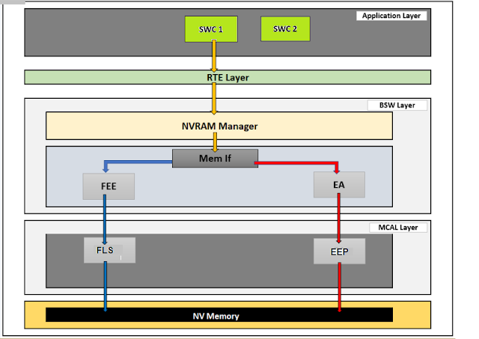
Diagnostics: AUTOSAR BSW Software Stack

Slide 18
Diagnostics: Delta Application Stacks
Appldaig: SWC responsible for managing diagnostic services. Configured using DaVinci Configurator and Developer.
Demwrap (legacy): SWC responsible for handling DEM related functions.
Coding (legacy): SWC responsible for handling the NVM related functions.
ECU Ext. (bootloader) (part legacy): SWC responsible for bootloader functionalities. For example, the number of times the ECU is flashed is to be stored in the NVM.
Note: Legacy means the stack is already implemented and can be used in all projects. The files are supposed to be kept static and are not to be changed.

Slide 19
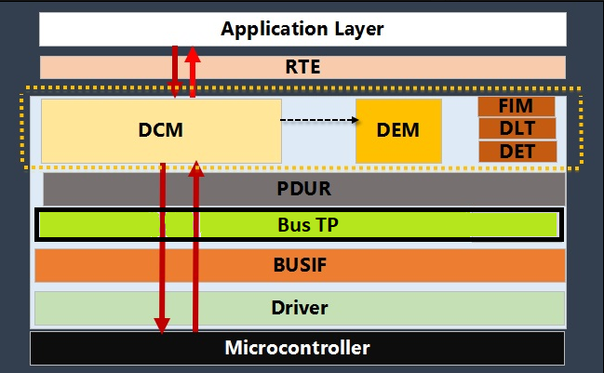
AUTOSAR DCM STACK
DCM is responsible for handling the diagnostics related communication, ie the diagnostic services. It receives the service request, validates it, takes proper action and sends the response (either positive or negative)
AUTOSAR DCM supports standard diagnostic protocols like UDS – ISO14229-1, OBD – ISO15031-5 over CAN, FlexRay and MOST bus.

Slide 20
AUTOSAR DCM STACK
DCM is subdivided into 3 parts:
1. DSL (Diagnostic Session Layer)
Handles the diagnostic session and takes care of session timing
Receives service request from PDUr and sends to the DSD. Similarly, receives the service response from DSD and sends it to PDUr.
Keeps track of current session and manages the non-default session server time-out, if not in default session and server time out happens, then resets to default session.
ECU Sessions:
Default Session: Normal condition
Extended Session: To unlock additional diagnostic services
Programming session: To program the ECU

Slide 21
AUTOSAR DCM STACK
1. DSL (Diagnostic Session Layer)
In Davinci Configurator, under Dcm → DcmDsl, we are able to configure the session related settings like the protocol type, service request repress limits, DSL data buffer size etc
Note: The maximum data length as per ISO 15765 CAN TP is 4095 bytes.
2. DSD (Diagnostic Service Dispatcher)
Check the validity of incoming request, ie session type and security access level.
Receives service request from DSL and sends it to DSP, which sends the response signal back after the processing
Checks the request SID with the pre-defined Service Identifier Table, if approved sends it to DSD, else rejects with NRC 0x11 i.e. Service not supported to the DSL.
Verifies if service is supported in the current diagnostic session, else rejects with the NRC (0x7F) which means Service is not supported for active session.

Slide 22
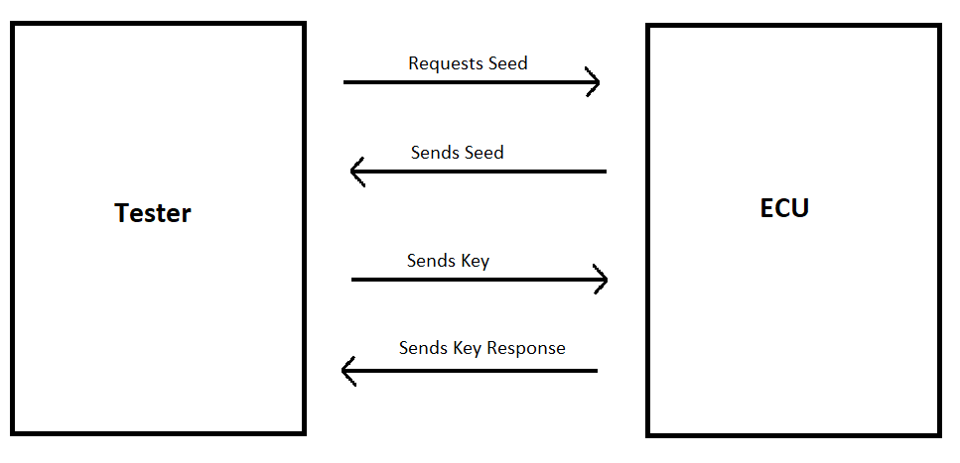
AUTOSAR DCM STACK
2. DSD (Diagnostic Service Dispatcher)
Verifies the security access level: Some diagnostic services have restricted security access levels. Gets the current security access level from DSL and checks if the request is allowed, if not, rejects with the NRC 0x33 which means Security access denied.
UDS Service 0x27 is used to handle security access levels
27 01 and 27 02 = Level 1 (figure-Seed Key)
27 11 and 27 12 = level 2
27 0A and 27 0B = level 3

Slide 23
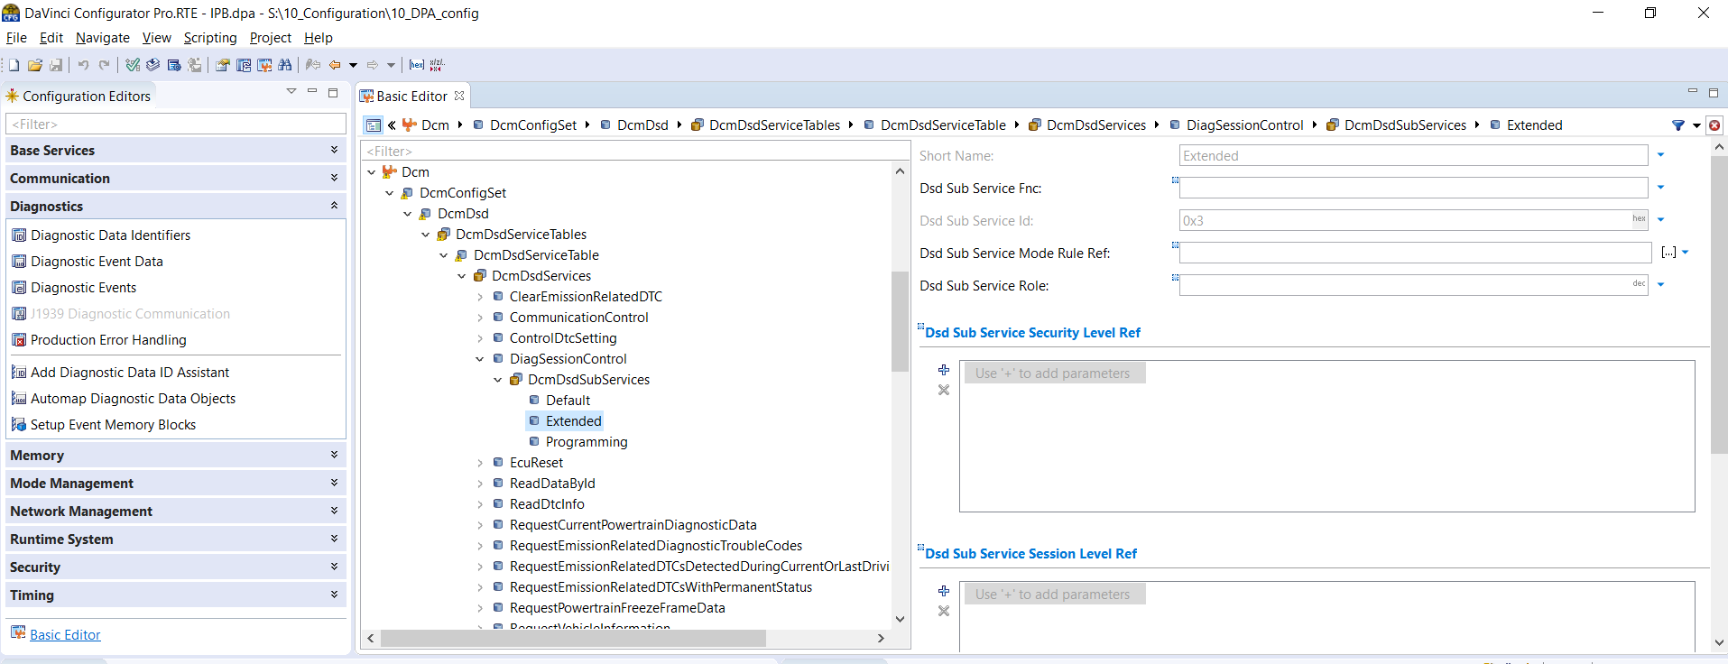
AUTOSAR DCM STACK
2. DSD (Diagnostic Service Dispatcher)
In configurator, under “Dcm” → “DcmDsd” → “DcmDsdServiceTable” → “DcmDsdServices” we can see different UDS Service Codes. Which can be expanded to get their sub functions.

Slide 24
AUTOSAR DCM STACK
3. DSP (Diagnostic Service Processor)
Processes the received service request.
After receiving the request from DSD, DSP checks it’s format & length, if approved, gets the required data from DEM or SWC (appldiag) and then assembles the response.
If the request doesn’t have the proper format or length, DSP sends a negative response with the NRC 0x13, ie “Invalid message lenth/format”.
DSP also checks the specific sub function with the service, if not supported, DSP sends a negative response with the NRC 0x12, ie “Sub function not supported”.

Slide 25
AUTOSAR DCM STACK
3. DSP (Diagnostic Service Processor)
In Davinci Configurator, under “Dcm” → “DcmDsp” → “DcmDspDatas”, we can configure the DID name and DID size in Bits. (The NRC 0x13 error “incorrect message length or format”.)
Under “DcmDsp” → “DcmDspDidInfos”→ “DcmDspDidRead”, we can configure the security and which session(Default/Extended) a DID is to be used. The NRC “not supported in present active session” can occur because of this.
Under “DcmDsp” → “DcmDspDids”, we can configure the DID number to be used for each DID name.

Slide 26
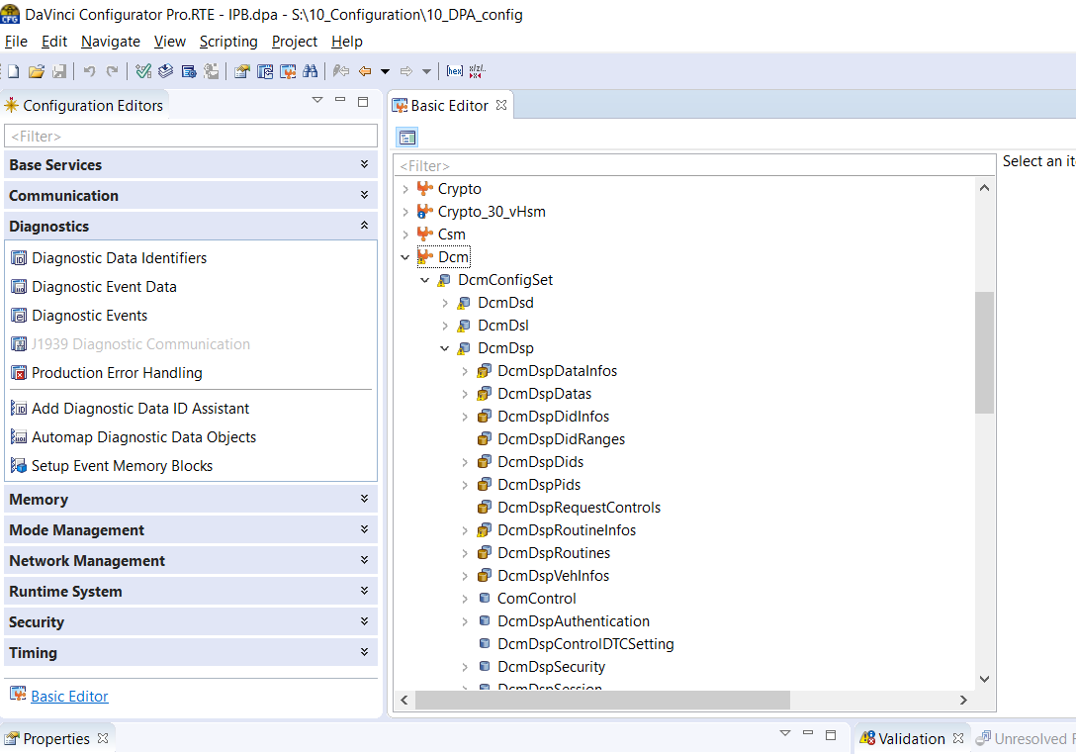
AUTOSAR DCM STACK

Slide 27
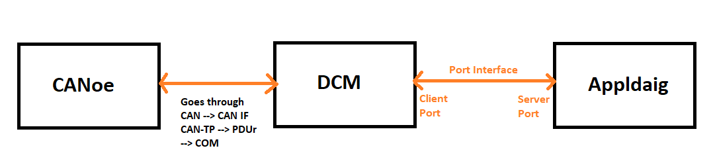
DCM Implementation
Reading & Writing constant Data
Eg: appldiag_S_DataServices_Data_DiagnServi_ReadDataByIdentASAMODXFileIdent_ReadData

Slide 28
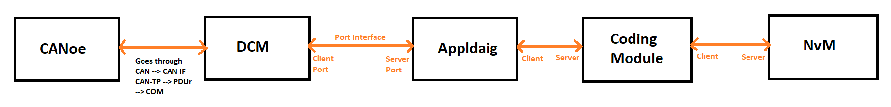
DCM Implementation
Reading & Writing Data (to/from NvM)
The coding module provides api’s (coding calls) to appldiag to read and write from the NvM
Eg: Reading data from NvM: appldiag_S_DataServices_Data_DiagnServi_TABROW_ActivOfDevelMessa_Read_ReadData
Writing data to NvM:
appldiag_S_DataServices_Data_DiagnServi_TABROW_NeuCalibData_Read_WriteData

Slide 29
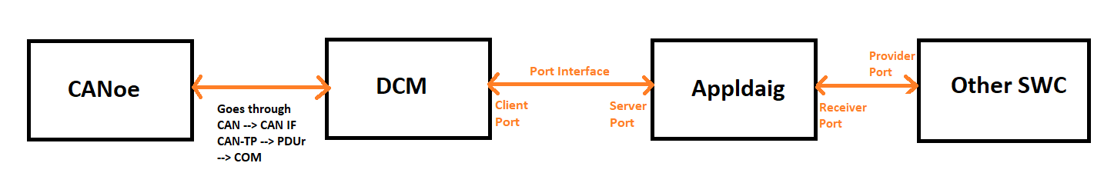
DCM Implementation
Reading Data from other SWC
Eg: DID 0x05DA

Slide 30
Further Resources
CAN TP ISO 15765: https://www.youtube.com/watch?v=hSoLFaI4-qg
ISO 14229 UDS:
https://desoeap16.delta.corp/svn/IPB_PPE_auto_porsche/trunk/20_Design/23_Software/2310_HowTo/HowTo_Diagnostics/ISO_14229-1_2013-03.pdf
TechnicalReference_Dcm.pdf
https://desoeap16.delta.corp/svn/External_IPB_auto_pag/trunk/20_Design/23_Software/2304_Implementation/10_APPL/10_ComController/1001_Common/70_Tools/10_AR_ToolChain/Components/Dcm/Documentation/TechnicalReference_Dcm.pdf

Slide 31
Smarter. Greener. Together.

